Slide 1
Multimodal Fusion for Abusive Speech Detection With Liquid Neural Networks
Team 02

Slide 2
Team 02
Paval KS | CB.EN.U4AIE20047
Vishnu Radhakrishnan | CB.EN.U4AIE20074
Krishnan KM | CB.EN.U4AIE20031

Slide 3
Introduction
The task is detecting abusive speech or language in Indic languages on online platforms
Using audio recordings and transcribed text data from online platforms like Share Chat.
Difference between offensive and abusive language:
Abusive language has a strong component of intentionality;
the definition of offensiveness has more emphasis on lexical content and the receiver's emotional response.

Slide 4
Research Gap
Research Gap 1:
Hate speech detection research predominantly focuses on high-resource languages, neglecting the linguistic diversity of India.
Limited annotated data, linguistic complexities, and dialectal variations hinder the creation of accurate and reliable detection systems.
Bridging the gap in research for low resource Indian languages is essential for ensuring inclusivity and equity in online content moderation.

Slide 5
Research Gap
Research Gap 2: Potential of Liquid Neural Networks (LNN)
Most hate speech detection models rely on Transformer-based architectures.
Transformers show limitations in handling dynamic and evolving data patterns, as well as challenges in adapting to noisy or unpredictable data streams.
Unlike Transformer-based models, LNNs, with their fluidity, are better equipped to handle unexpected or noisy data, making them more resilient in real-world scenarios.
Introduction of Liquid Neural Networks (LNN) as an untapped potential for advancing hate speech detection.

Slide 6
Contribution
Develop a multimodal, multilingual novel methodology for abuse detection
Bridge the gap in hate speech detection research by focusing on low resource Indian languages.
Explore the potential of Liquid Neural Networks (LNNs) for abuse detection in text.
Improve on the performance of conventional neural networks using LNN and fusion techniques.

Slide 7
Objectives
Implement a multimodal approach for abusive speech detection in monolingual settings by integrating audio and text modalities
Text transcriptions are extracted from audio recordings for analysis.
Extend the classification framework to cross-lingual settings.
Evaluate the performance of the developed model to assess its capabilities across diverse linguistic context.

Slide 8
Methodology
Transcription:
Transcribe audio data of different Indian languages from the ShareChat dataset
We use the Google Web Speech API (recognize_google) for transcription.
Handles exceptions such as unknown audio (sr.UnknownValueError) and request errors (sr.RequestError), for smooth processing.
Generates a CSV file containing the filename and its corresponding transcription.

Slide 9
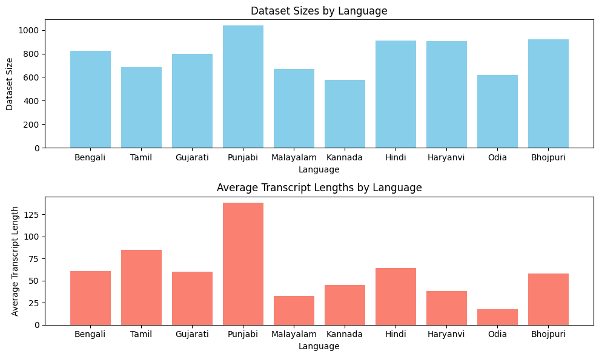
Methodology – Transcription Meta Data

Slide 10
Methodology – Transcription Meta Data
File Name | Dataset Size | Average transcription length
Bengali | 823 | 61.0559
Tamil | 687 | 84.9476
Gujarati | 796 | 60.1043
Punjabi | 1037 | 138.118
Malayalam | 670 | 32.4881
Kannada | 577 | 45.3137
Hindi | 913 | 64.2563
Haryanvi | 907 | 38.1874
Odia | 620 | 17.8516
Bhojpuri | 922 | 58.2126

Slide 11
Methodology
Feature Extraction:
Extract text characteristics from transcriptions
Extract spectrogram images from audio
Model Development:
Design liquid neural network architectures for classification.
Train one LNN model using text data as input and another CNN model using spectrograms as input. Each model will learn to classify the input data independently.

Slide 12
Methodology
Late Fusion:
Combine the predictions from both LNN and CNN models using a fusion technique.
Late Fusion is performed using a Weighted Average
Evaluation and Analysis:
Evaluate the model’s performance on validation and test sets.
Analyse cross-lingual and multilingual aspects to address language-specific challenges in abusive speech detection.

Slide 13
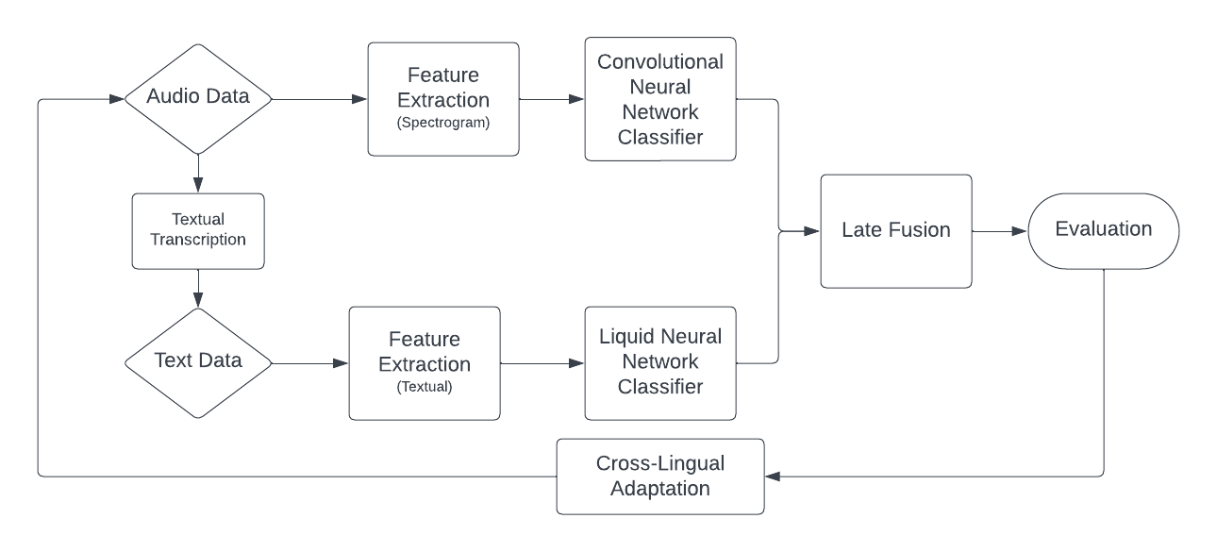
Methodology

Slide 14
Liquid Neural Networks
Inspired by C. elegans Neurons:
Hasani's neural network is inspired by the activation and communication patterns of C. elegans neurons through electrical impulses.
Dynamic Parameters:
Parameters in the network change over time based on nested sets of differential equations, providing flexibility in its structure.
Fluidity and Resilience:
Unlike traditional neural networks, "liquid" network exhibits fluidity, allowing it to adapt to changes in incoming data streams.
This adaptability makes it more resilient to unexpected or noisy data, enhancing its robustness.

Slide 15
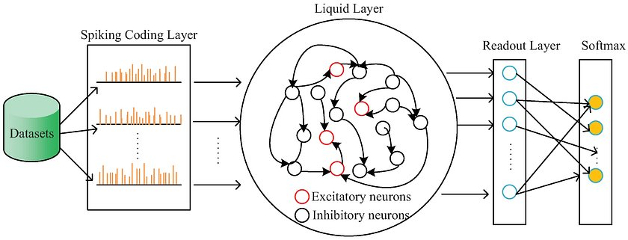
Liquid Neural Networks
Revolutionizing AI: The Emergence of Liquid Neural Networks as the Future of Intelligence | by Ahmed Ghazouani | Feb, 2024 | Medium​

Slide 16
Dataset Description
Name: ADIMA
Contains 11,775 audio recordings from ShareCHAT chatrooms
Total duration of 65 hours for 10 Indic Languages
Hindi (Hi), Bengali (Be), Punjabi (Pu), Haryanvi (Ha), Kannada (Ka), Odia (Od), Bhojpuri (Bh), Gujarati (Gu), Tamil (Ta) and Malyalam (Ma)
Recordings spoken by 6446 different users making it a highly diverse multilingual and multi-user dataset.
Balanced Dataset
Abusive Samples = 5108
Non-Abusive Samples = 6667

Slide 17
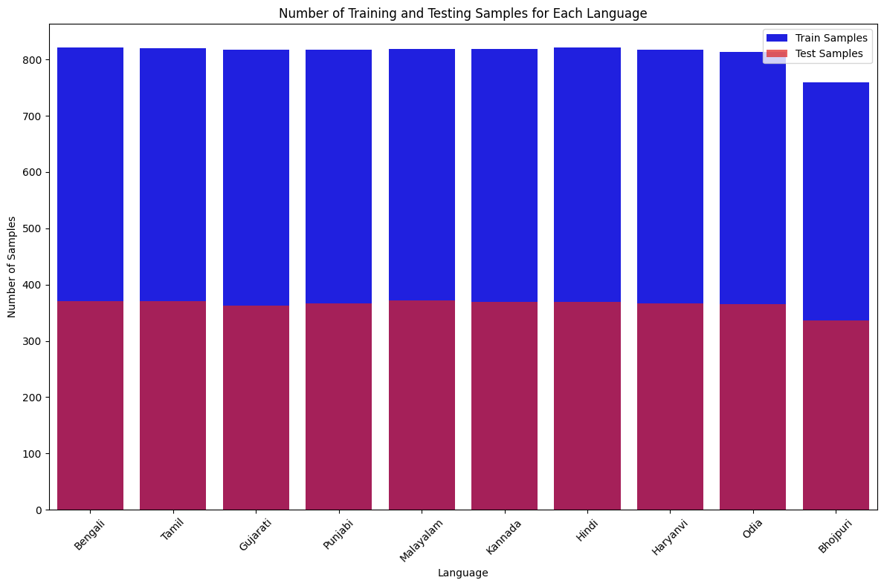
Dataset Description

Slide 18
Results : Transcription
The confidence value is an estimate between 0.0 and 1.0. It's calculated by aggregating the "likelihood" values assigned to each word in the audio. A higher number indicates an estimated greater likelihood that the individual words were recognized correctly.​
Language | Transcription example | Confidence Score
Bengali | মাদারচোদ তুই খানকির ছেলে গুদমারানি খানকির ছেলে খানকির ছেলে গুদমারানি খানকির ছেলে মাদারচোদ | 0.88447982
Gujarati | અમે તારી બેન નો ભોંસડો મારે માદર ચૌદ તારી માનો પિકો મારે તારી માનો ભોંસડો ઉપર સંપર્ક મારીને ચોદો ભોંસ મારીના તારી માનો પિકો મારે ભોંસડો તારા બાપને તારી માનો લોડો મારે | 0.86772144
Kannada | ನಿಮ್ಮ ಮನೆಗೆ ನಿಮ್ಮವ್ವನ್ ತುಲ್ಲ್ ನಡಿ ನಡಿ ನಡಿ ನಡಿ ನಡಿ ಆಯ್ತಾ ಬಿಡುತ್ತೆ ಯಾರು | 0.83882803
Punjabi | ਹੈਦਰਾਬਾਦ ਤੇਰੇ ਮਾ ਦੇ ਜੋ ਦੇ ਕੇ ਲੁਧਿਆਣੇ ਦਾ ਵਿਆਹ ਆ ਭੈਣ ਦੇ ਵੱਡੇ ਲਿਆ ਦਿਆ ਸਧਰਾ ਬਾਜਵਾ ਤੇਰੇ ਮਾ ਦਿਆ ਗਰਾਟਾ ਅੱਜ ਮੈਂ ਰਹਿਣ ਲੱਗ ਗਿਆ ਮੈਂ ਇੱਕ ਹੋਇਆ ਆ ਤੇਰੇ ਭੈਣ ਦਾ ਵੱਡਾ ਮਾੜਾ ਹਜੇ ਓਏ ਓਏ ਓਏ ਓਏ ਓਏ ਓਏ ਹੋਏ ਦੋਵੇਂ ਸਾਡੇ ਭੈਣ ਨੂੰ ਲਾਨਾ ਆ ਤੁਹਾਡੇ ਨਾਲ ਦੁਬਲੇ ਗੱਡੀਆਂ ਦੇ | 0.96483725
Tamil | ஓடு ஓடு ஓடு ஓடு ஓடு ஓடு ஓடு ஓடு ஓடு ஓடு ஓடு ஓடு ஓடு ஓடு அப்படியே உங்க அம்மா கூட அப்படி இல்லன்னா உங்க அப்பன் பூல போச்சுன்னு அப்பா | 0.85019755
Malayalam | കുട്ടിച്ചാത്തൻ ഐ ലവ് യു ഡാ നീ അടിച്ചു കേട്ടോ | 0.69188786

Slide 19
Results – Monolingual (CNN)
Training a CNN with the spectrogram images (Bengali audio), for our task.
Unimodal annotations for Bengali in ADIMA dataset:
Training data points: 1644
Testing data points: 740
Layer (type) | Output Shape | Param #
conv2d (Conv2D) | (None, 98, 98, 32) | 320
max_pooling2d (MaxPooling2D) | (None, 49, 49, 32) | 0
conv2d_1 (Conv2D) | (None, 47, 47, 64) | 18496
max_pooling2d_1 (MaxPooling 2D) | (None, 23, 23, 64) | 0
conv2d_2 (Conv2D) | (None, 21, 21, 128) | 73856
max_pooling2d_2 (MaxPoolin | (None, 10, 10, 128) | 0
flatten (Flatten) | (None, 12800) | 0
Dense (Dense) | (None, 128) | 1638528
Dense_1 (Dense) | (None, 1) | 129
Total params: 1731329 (6.60 MB) Trainable params: 1731329 (6.60 MB) Non-trainable params: 0 (0.00 Byte)

Slide 20
Results – Monolingual (CNN)
Training Accuracy | 0.68
Testing Accuracy | 0.73
Training F1 Score | 0.75
Testing F1 Score | 0.80
Training AUC | 0.83
Testing AUC | 0.80

Slide 21
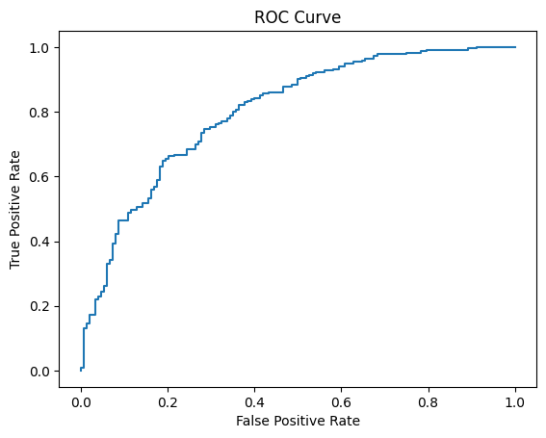
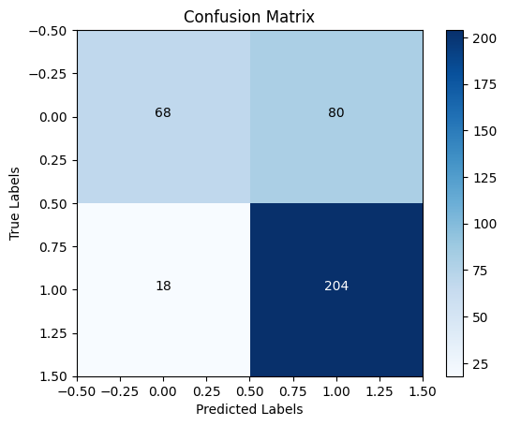
Results – Monolingual (CNN)

Slide 22
Results – Monolingual (LNN)
Training an LNN with the spectrogram images (Bengali audio), for our task.
Unimodal annotations for Bengali in ADIMA dataset:
Training data points: 1644
Testing data points: 740
Layer (type) | Output Shape | Param #
embedding_3 (Embedding) | (None, 100,32) | 320000
Conv1d (Conv1D) | (None, 98, 32) | 3104
Max_pooling1d_6 (MaxPooling 1D) | (None, 49, 32) | 0
Conv1d_10 (Conv1D) | (None, 47, 64) | 6208
Max_pooling1D_7 (MaxPooling 1D) | (None, 23, 64) | 0
Conv1D_11 (Conv1D) | (None, 21, 64) | 12352
Flatten_12 (Flatten) | (None, 1344) | 0
Reshape_3 (Reshape) | (None, 1, 1344) | 0
Rnn_3 (RNN) | (None, 1, 25) | 580638
Global_average_pooling1d_3 (GlobalAveragePooling1D) | (None, 25) | 0
Dense_21 (Dense) | (None, 1) | 26
Total params: 922328 (3.52 MB) Trainable params: 922328 (3.52 MB) Non-trainable params: 0 (0.00 Byte)

Slide 23
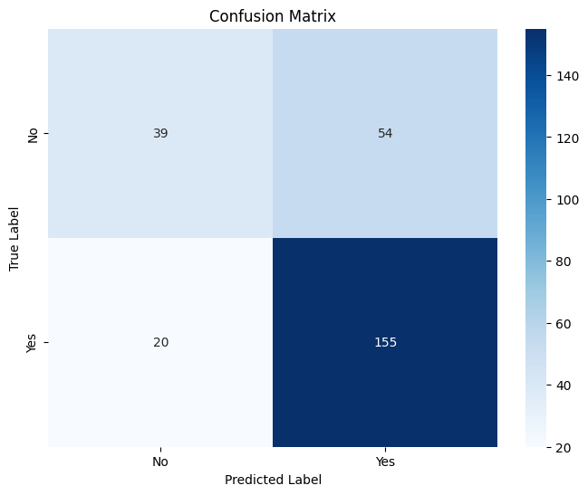
Results – Monolingual (LNN)
Testing Accuracy | 0.72
Testing F1 Score | 0.80

Slide 24
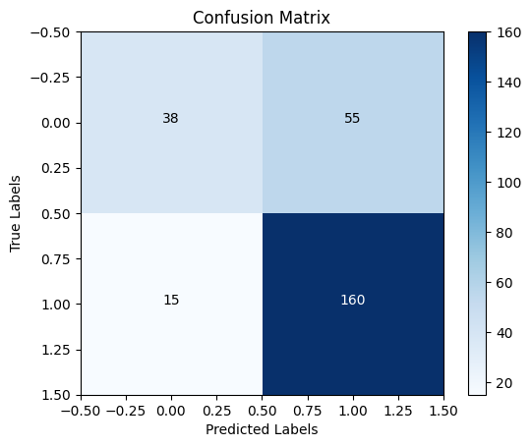
Results – Monolingual (CNN + LNN)
Testing Accuracy | 0.73
Training F1 score | 0.82
Testing AUC | 0.66

Slide 25
Results – Multi Lingual Adaptation (CNN)
Accuracy | 0.75
F1 score | 0.73
AUC | 0.84

Slide 26
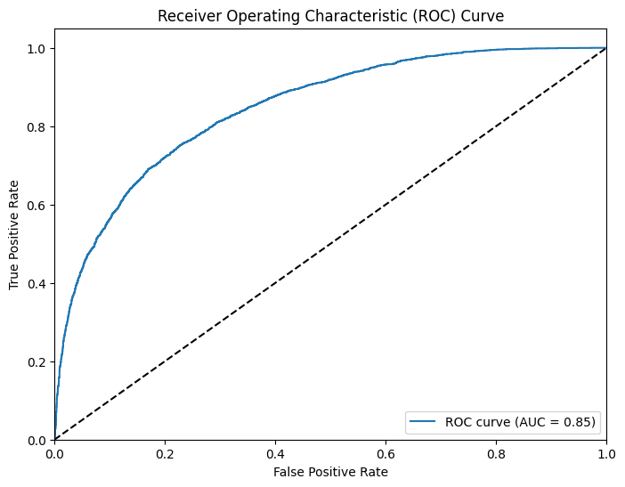
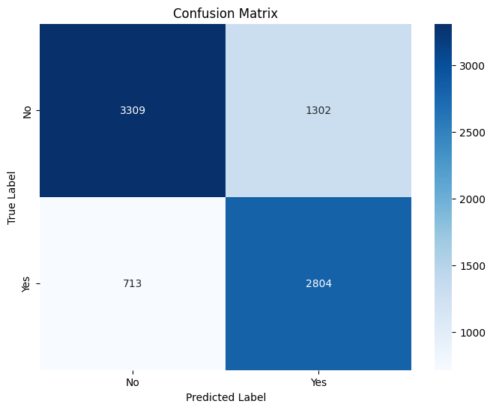
Results – Multi Lingual Adaptation (CNN)

Slide 27
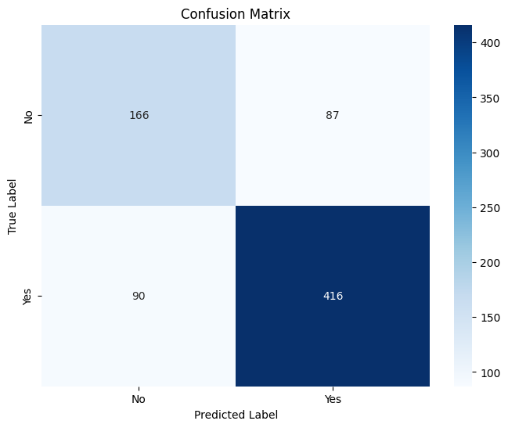
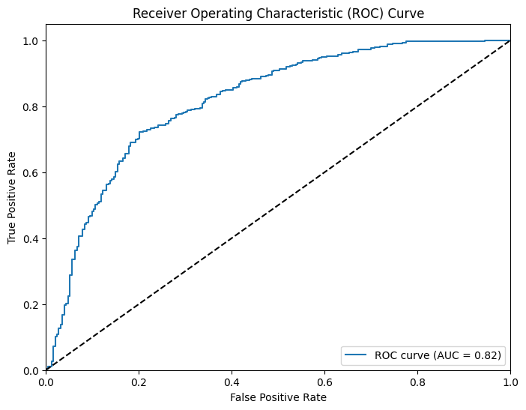
Results – Multi Lingual Adaptation (CNN)
Bhojpuri
Accuracy | 0.76
F1 score | 0.82

Slide 28
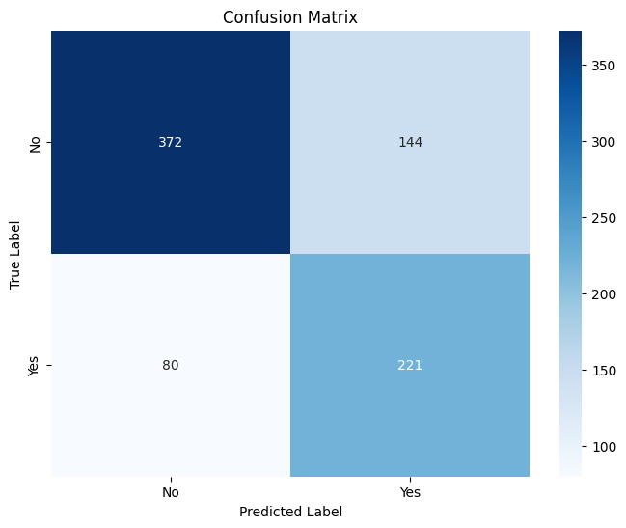
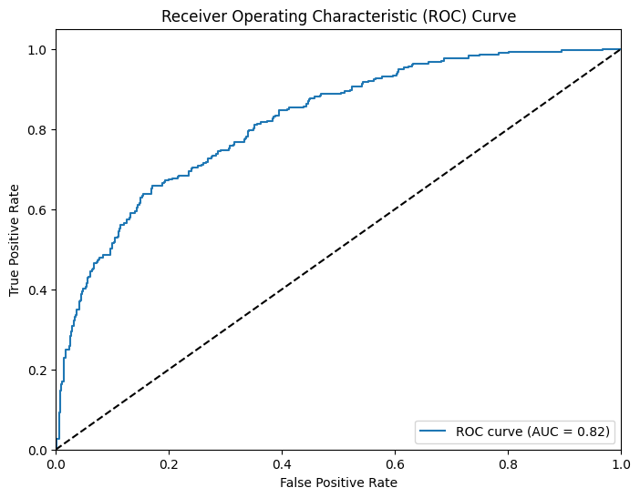
Results – Multi Lingual Adaptation (CNN)
Gujarati
Accuracy | 0.72
F1 score | 0.66

Slide 29
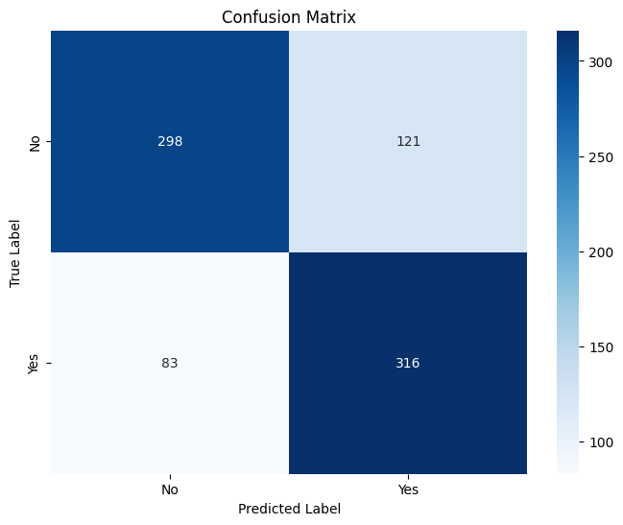
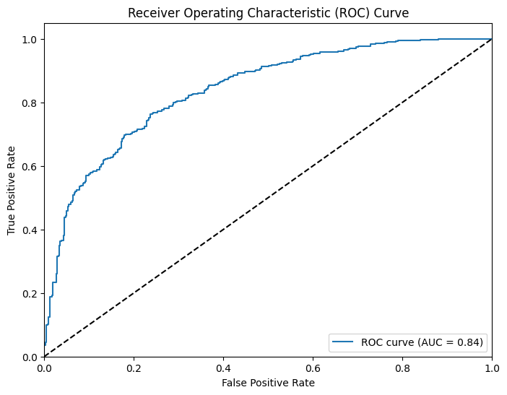
Results – Multi Lingual Adaptation (CNN)
Haryanvi
Accuracy | 0.75
F1 score | 0.75

Slide 30
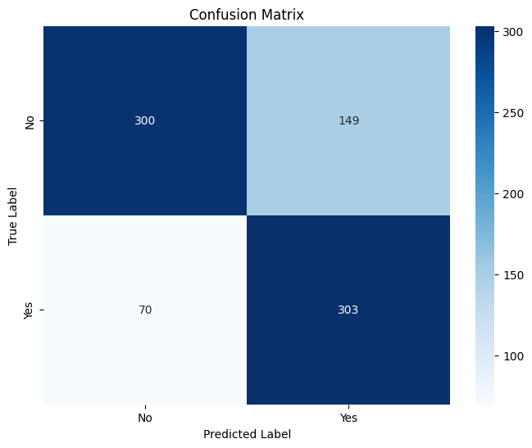
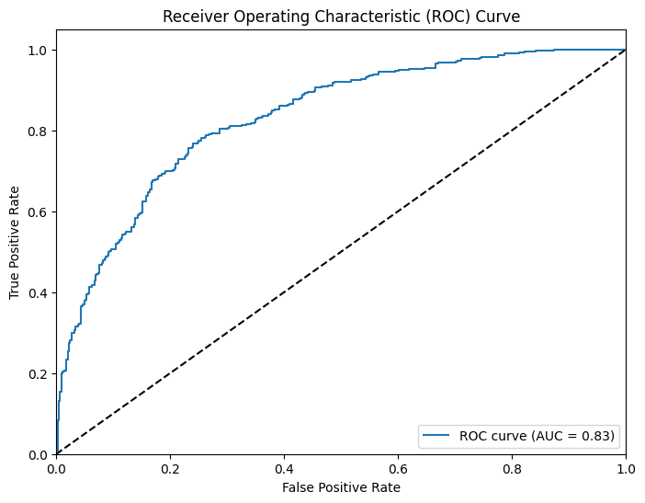
Results – Multi Lingual Adaptation (CNN)
Hindi
Accuracy | 0.73
F1 score | 0.73

Slide 31
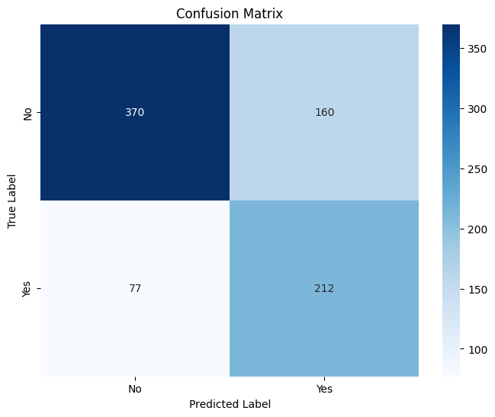
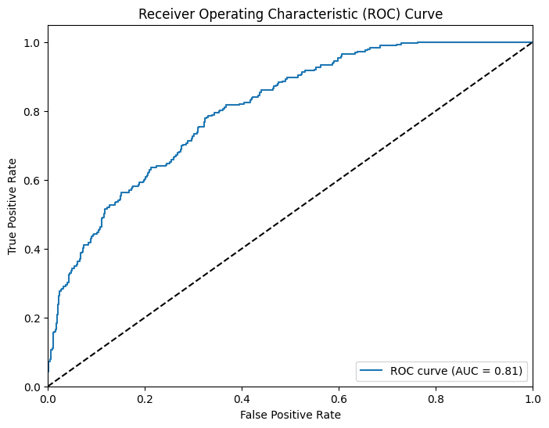
Results – Multi Lingual Adaptation (CNN)
Kannada
Accuracy | 0.71
F1 score | 0.64

Slide 32
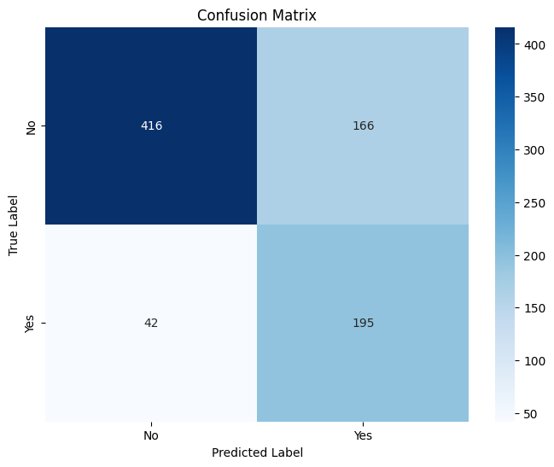

Results – Multi Lingual Adaptation (CNN)
Malayalam
Accuracy | 0.74
F1 score | 0.65

Slide 33
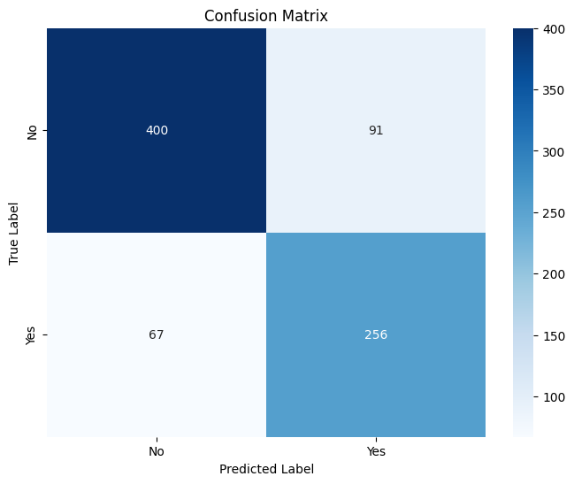
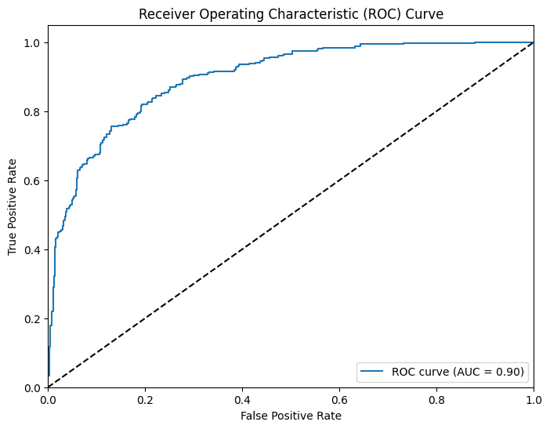
Results – Multi Lingual Adaptation (CNN)
Odia
Accuracy | 0.80
F1 score | 0.76

Slide 34
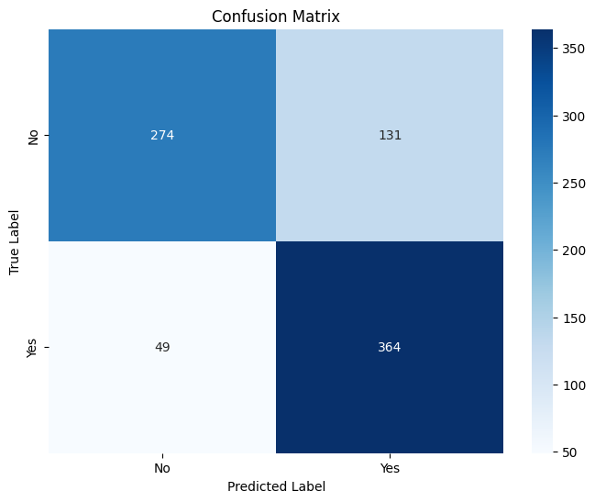
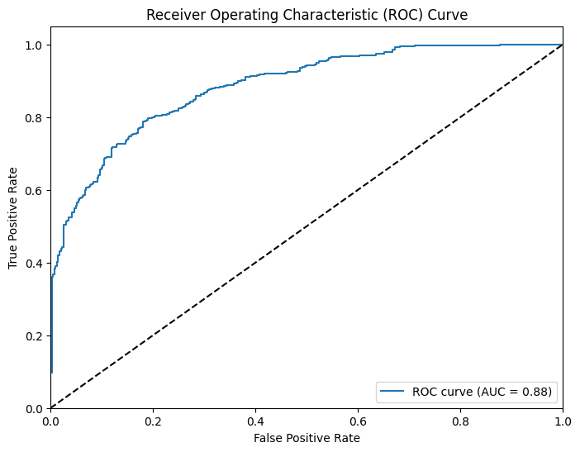
Results – Multi Lingual Adaptation (CNN)
Punjabi
Accuracy | 0.78
F1 score | 0.80

Slide 35
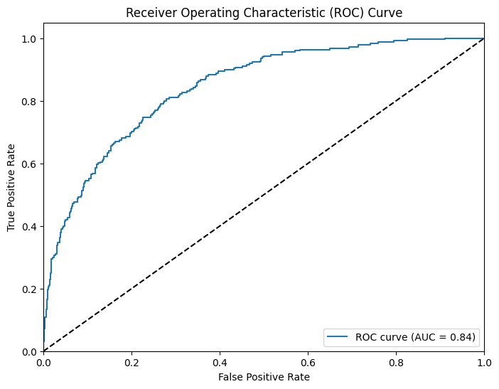
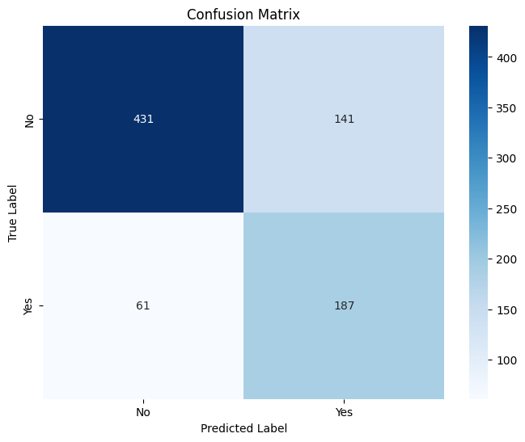
Results – Multi Lingual Adaptation (CNN)
Tamil
Accuracy | 0.75
F1 score | 0.64

Slide 36
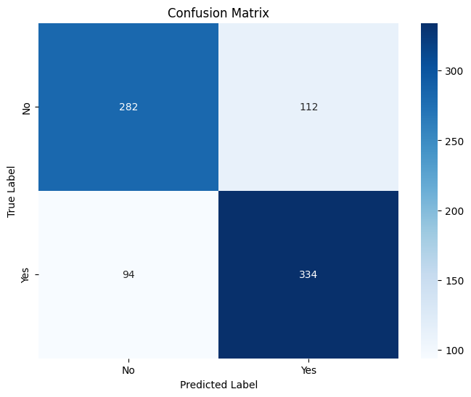
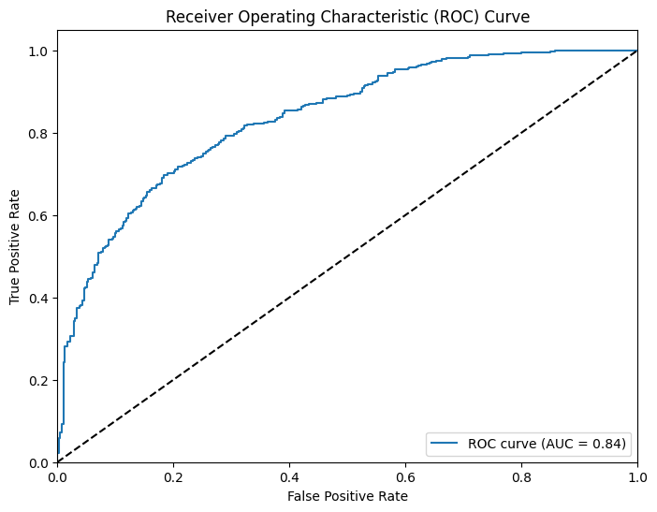
Results – Multi Lingual Adaptation (CNN)
Bengali
Accuracy | 0.74
F1 score | 0.76

Slide 37
Results – Multi Lingual Adaptation (LNN)
Accuracy | 0.85
F1 score | 0.84

Slide 38
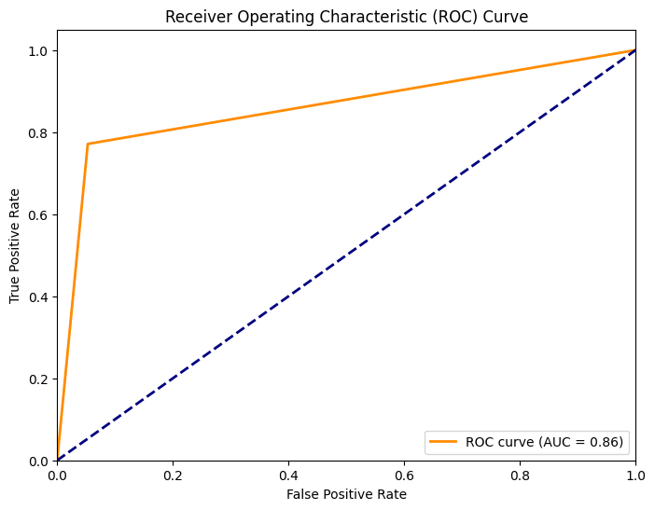
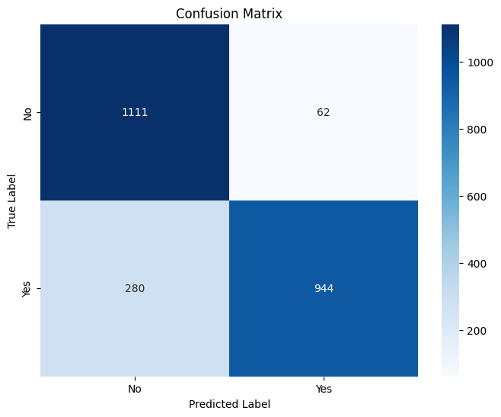
Results – Multi Lingual Adaptation (LNN)

Slide 39
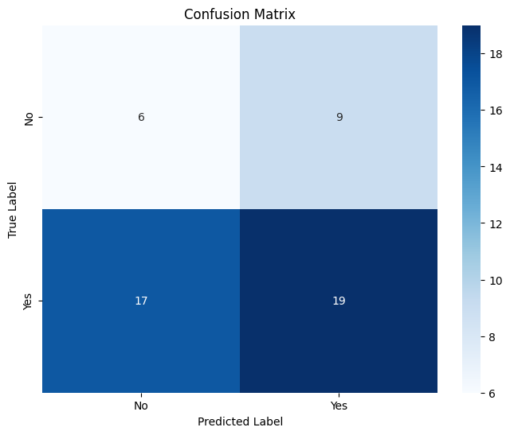
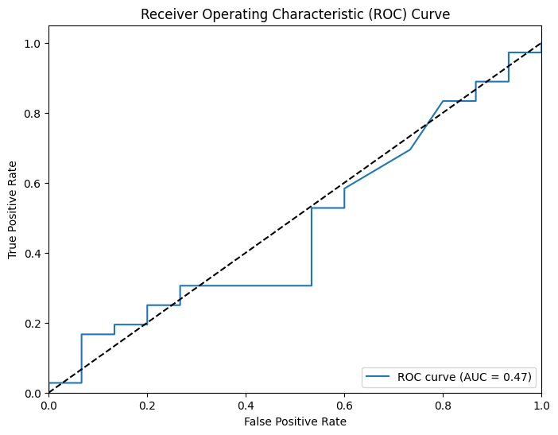
Results – Multi Lingual Adaptation (LNN)
Gujarati
Accuracy | 0.73
F1 score | 0.62

Slide 40
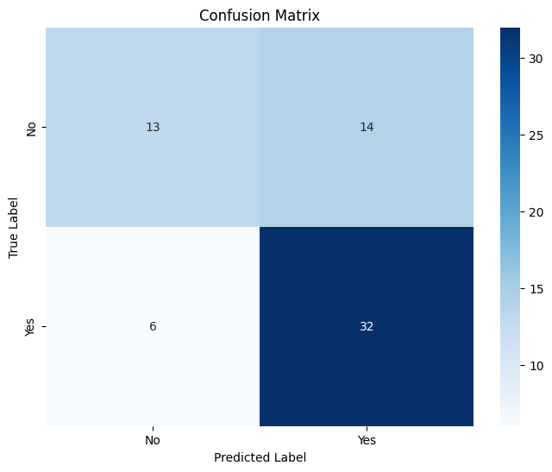
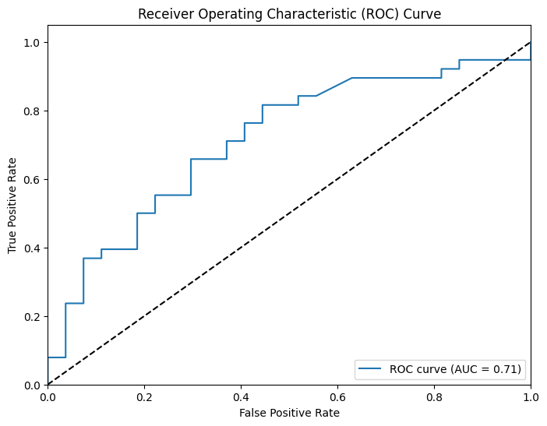
Results – Multi Lingual Adaptation (LNN)
Punjabi
Accuracy | 0.69
F1 score | 0.76

Slide 41
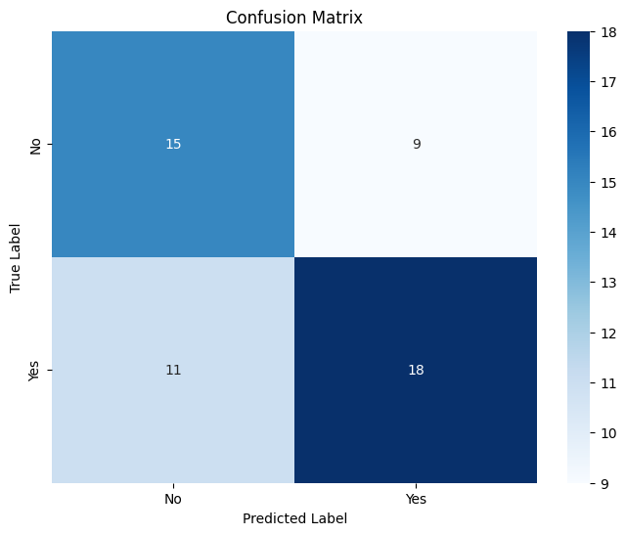
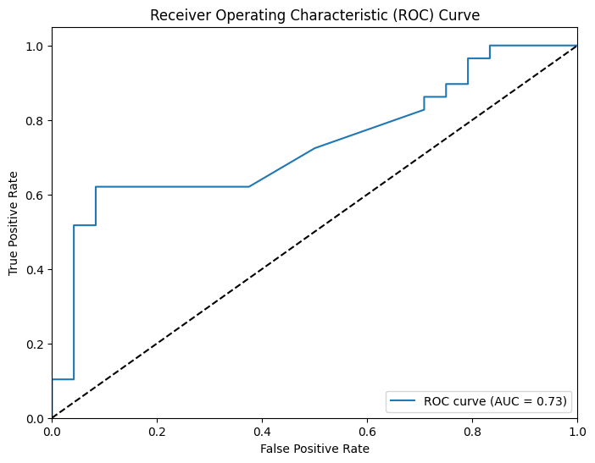
Results – Multi Lingual Adaptation (LNN)
Haryanvi
Accuracy | 0.62
F1 score | 0.64

Slide 42
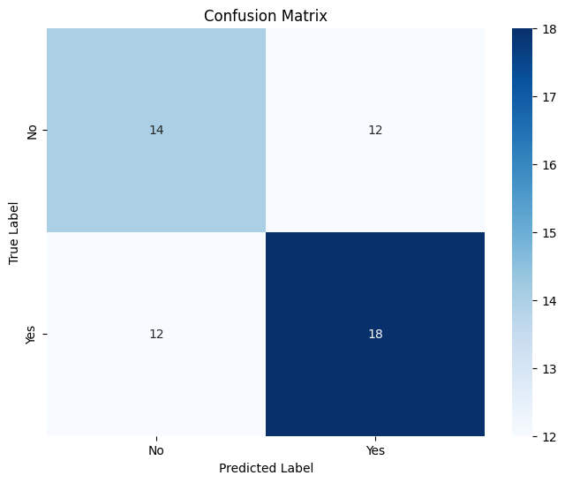
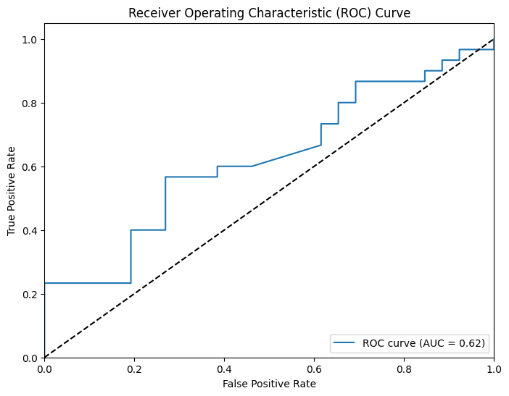
Results – Multi Lingual Adaptation (LNN)
Hindi
Accuracy | 0.57
F1 score | 0.6

Slide 43
Results – Multi Lingual Adaptation (LNN)
Bhojpuri
Accuracy | 0.49
F1 score | 0.59

Slide 44
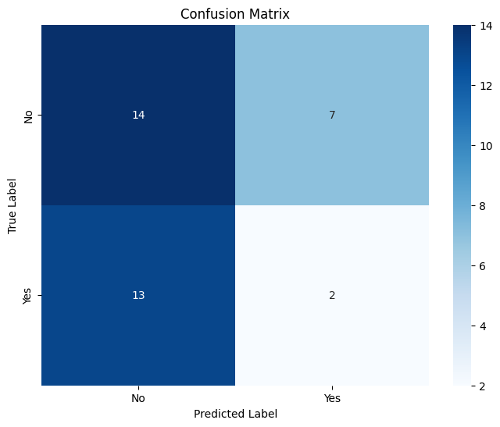
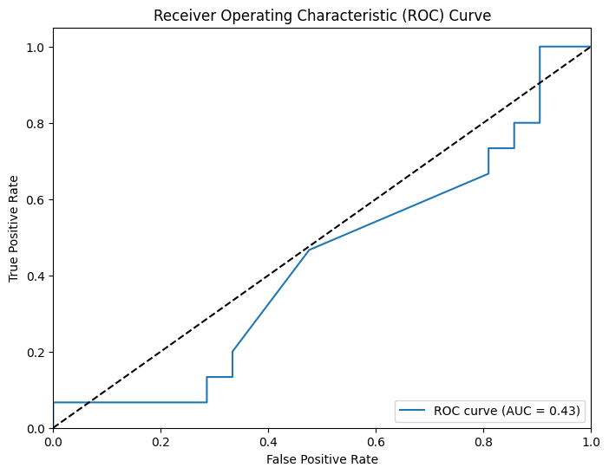
Results – Multi Lingual Adaptation (LNN)
Kannada
Accuracy | 0.49
F1 score | 0.16

Slide 45
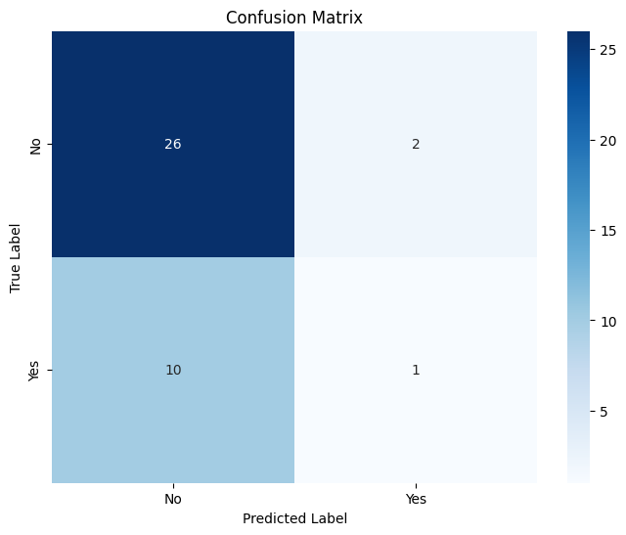
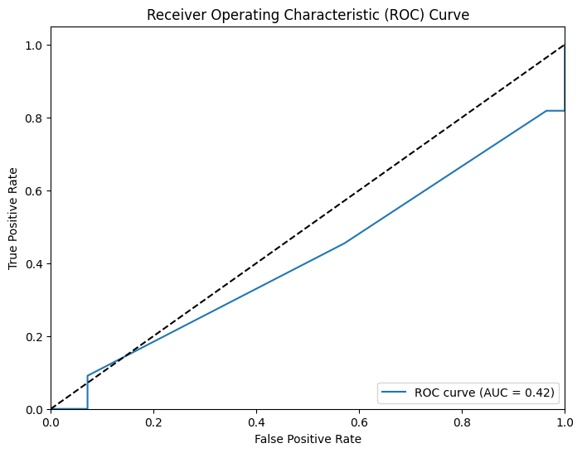
Results – Multi Lingual Adaptation (LNN)
Malayalam
Accuracy | 0.69
F1 score | 0.14

Slide 46
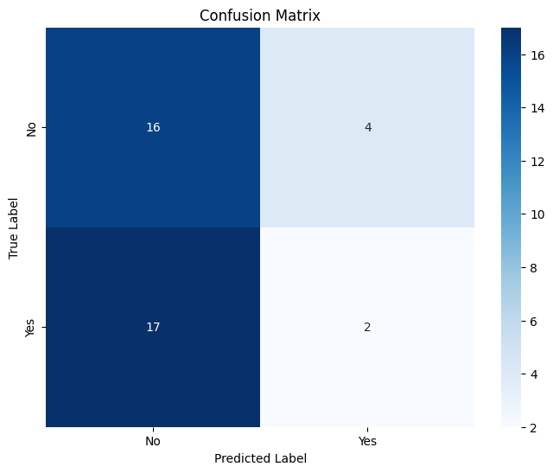
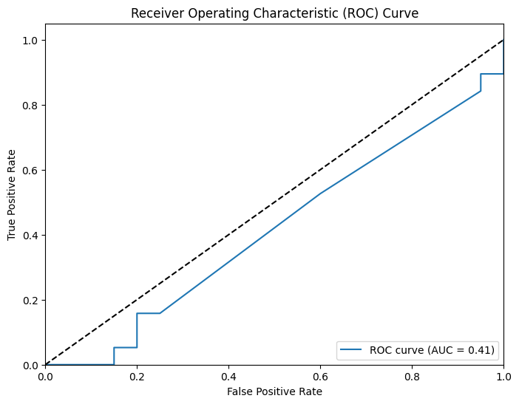
Results – Multi Lingual Adaptation (LNN)
Odia
Accuracy | 0.46
F1 score | 0.16

Slide 47
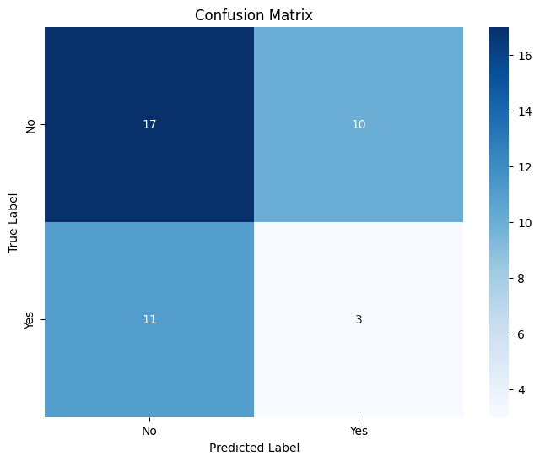
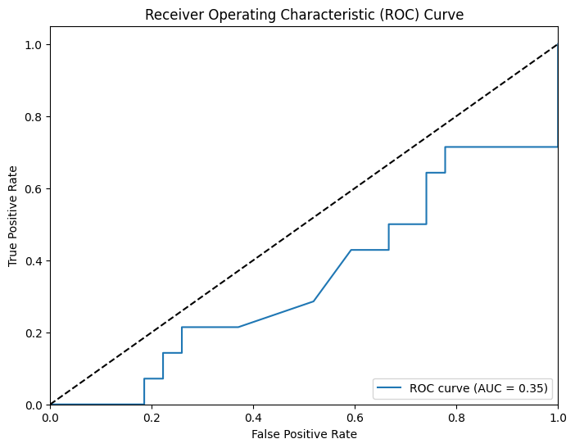
Results – Multi Lingual Adaptation (LNN)
Tamil
Accuracy | 0.48
F1 score | 0.22

Slide 48
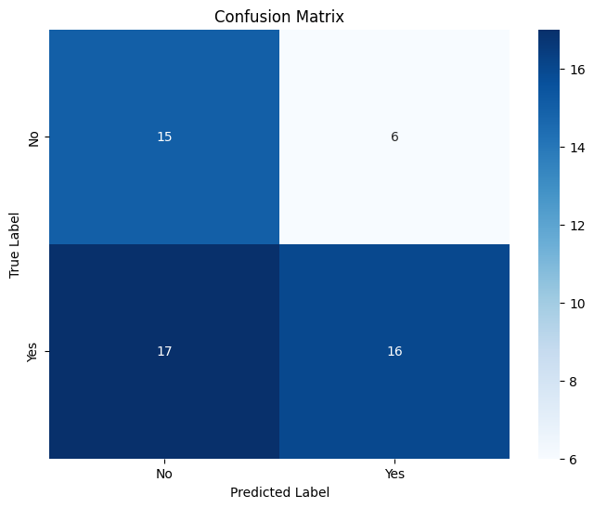
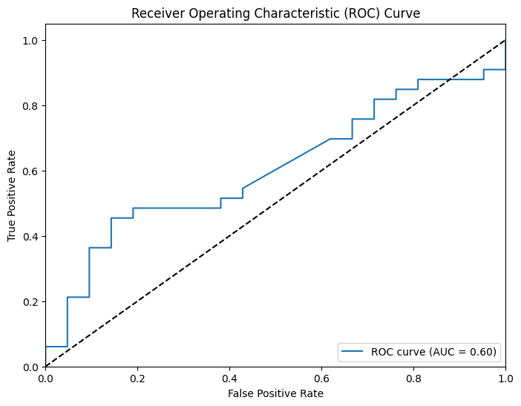
Results – Multi Lingual Adaptation (LNN)
Bengali
Accuracy | 0.57
F1 score | 0.58

Slide 49
Results – Multi Lingual Adaptation (CNN+LNN)
Accuracy | 0.77
F1 score | 0.72
AUC | 0.78

Slide 50
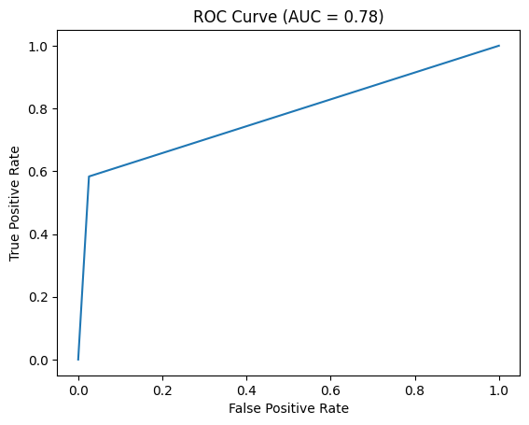

Results – Multi Lingual Adaptation (CNN+LNN)

Slide 51
Conclusion
Thus, we were able to develop a novel approach for abuse detection:
Utilising the features of multiple modalities, namely image and text.
Leveraging the powers of both LNNs and CNNs by combining their results in a late fusion technique.
Developing a Monolingual model for abuse detection and building on it by extending it to cross lingual settings, across multiple Indian languages.

Slide 52
References
“Liquid” machine-learning system adapts to changing conditions | MIT News | Massachusetts Institute of Technology
Speech-to-Text request construction | Cloud Speech-to-Text Documentation | Google Cloud
2006.04439.pdf (arxiv.org) Hasani, Ramin, et al. "Liquid time-constant networks." Proceedings of the AAAI Conference on Artificial Intelligence. Vol. 35. No. 9. 2021.
https://arxiv.org/pdf/2204.02263.pdf Sharon, Rini, et al. "Multilingual and multimodal abuse detection." arXiv preprint arXiv:2204.02263 (2022).
https://aclanthology.org/2023.findings-eacl.9.pdf Roychowdhury, Sumegh, and Vikram Gupta. "Data-efficient methods for improving hate speech detection." Findings of the Association for Computational Linguistics: EACL 2023. 2023.
https://www.isca-archive.org/interspeech_2023/thakran23_interspeech.pdf Thakran, Yash, and Vinayak Abrol. "Investigating Acoustic Cues for Multilingual Abuse Detection."
https://link.springer.com/chapter/10.1007/978-981-99-5974-7_34 Cheruvu, Sai Manoj, et al. "Vituperative Content Detection: A Multidomain Architecture Using OpenCV." International Conference on Advances and Applications of Artificial Intelligence and Machine Learning. Singapore: Springer Nature Singapore, 2022.
https://ieeexplore.ieee.org/document/10389225 X. Chen, X. Ye, M. Mohanty and S. Manoharan, "Detecting Offensive Posts on Social Media," 2023 International Conference on Electrical, Computer and Energy Technologies (ICECET), Cape Town, South Africa, 2023
https://www.isca-archive.org/interspeech_2023/spiesberger23_interspeech.pdf Spiesberger, Anika A., et al. "Abusive Speech Detection in Indic Languages Using Acoustic Features."

